Slide 1
Key Management; Other Public Key Cryptosystems
Notes:
Lecture slides by Lawrie Brown for “Cryptography and Network Security”, 4/e, by William Stallings, Chapter 10 – “Key Management; Other Public Key Cryptosystems”.

Slide 2
Outline
Key management with asymmetric encryption
Diffie-Hellman key exchange

Slide 3
Key Management (Public)
Public-key encryption helps address key distribution problems
Have two aspects of this:
  distribution of public keys
  use of public-key encryption to distribute secret keys
Notes:
One of the major roles of public-key encryption has been to address the problem of key distribution, with two distinct aspects: the distribution of public keys, and the use of public-key encryption to distribute secret keys.

Slide 4
Distribution of Public Keys
can be considered as using one of:
  public announcement
  publicly available directory
  public-key authority
  public-key certificates
Notes:
Several techniques have been proposed for the distribution of public keys, which can mostly be grouped into the categories shown.

Slide 5
Public Announcement
Users distribute public keys to recipients or broadcast to community at large
  eg. append PGP keys to email messages or post to newsgroups or email list
Major weakness is forgery
  anyone can create a key claiming to be someone else and broadcast it
  until forgery is discovered can masquerade as claimed user
Notes:
The point of public-key encryption is that the public key is public, hence any participant can send his or her public key to any other participant, or broadcast the key to the community at large. Its major weakness is forgery, anyone can create a key claiming to be someone else and broadcast it, and until the forgery is discovered they can masquerade as the claimed user.

Slide 6
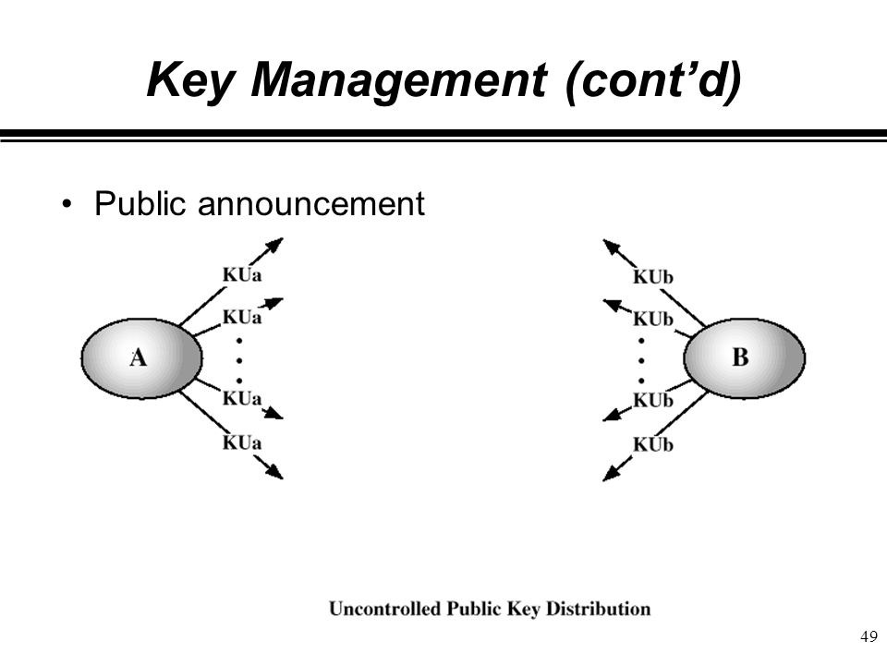

Slide 7
Publicly Available Directory
Can obtain greater security by registering keys with a public directory
Directory must be trusted with properties:
  contains {name, public-key} entries
  participants register securely with directory
  participants can replace key at any time
  directory is periodically published
  directory can be accessed electronically
    Weakness: directory must be trusted and still vulnerable to forgery
Notes:
A greater degree of security can be achieved by maintaining a publicly available dynamic directory of public keys. Maintenance and distribution of the public directory would have to be the responsibility of some trusted entity or organization. This scheme is clearly more secure than individual public announcements but still has vulnerabilities to tampering or forgery.

Slide 8
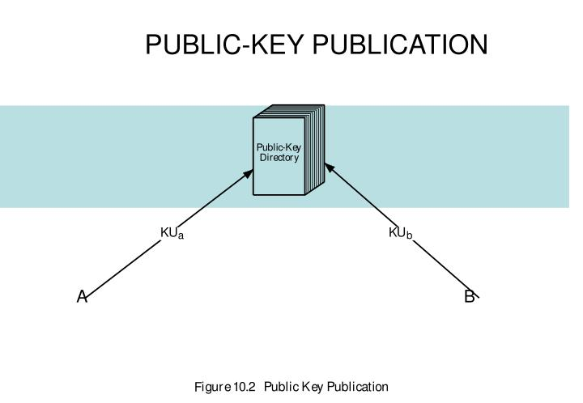

Slide 9
Public-Key Authority
Improve security by tightening control over distribution of keys from directory
Has properties of directory
And requires users to know public key for the directory
Then users interact with directory to obtain any desired public key securely
  does require real-time access to directory when keys are needed
Notes:
Stronger security for public-key distribution can be achieved by providing tighter control over the distribution of public keys from the directory. It requires users to know the public key for the directory, and that they interact with directory in real-time to obtain any desired public key securely. Note that a total of seven messages are required, as shown next.

Slide 10
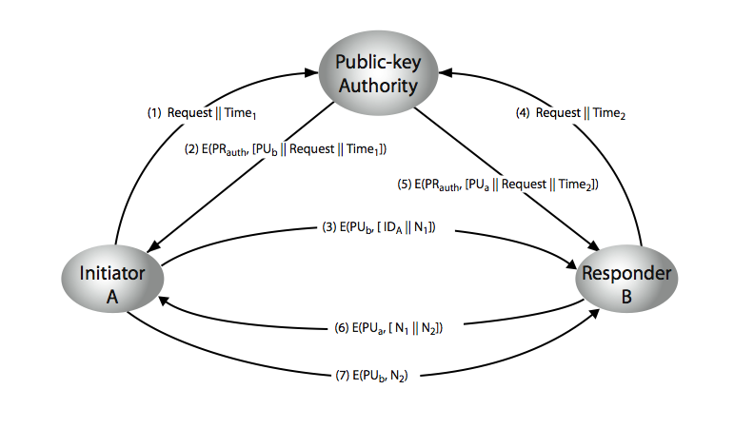
Public-Key Authority
Notes:
Stallings Figure 10.3 “Public-Key Authority” illustrates a typical protocol interaction. See text for details of steps in protocol.
Fig: Public key distribution Scenario

Slide 11
Public-Key Certificates
Certificates allow key exchange without real-time access to public-key authority
A certificate binds identity to public key
  usually with other info such as period of validity, rights of use etc
With all contents signed by a trusted Public-Key or Certificate Authority (CA)
Can be verified by anyone who knows the public-key authorities public-key
Notes:
An further improvement is to use certificates, which can be used to exchange keys without contacting a public-key authority, in a way that is as reliable as if the keys were obtained directly from a public-key authority. A certificate binds an identity to public key, with all contents signed by a trusted Public-Key or Certificate Authority (CA). This can be verified by anyone who knows the public-key authorities public-key.
One scheme has become universally accepted for formatting public-key certificates: the X.509 standard. X.509 certificates are used in most network security applications, including IP security, secure sockets layer (SSL), secure electronic transactions (SET), and S/MIME. Will discuss it in much more detail later.

Slide 12
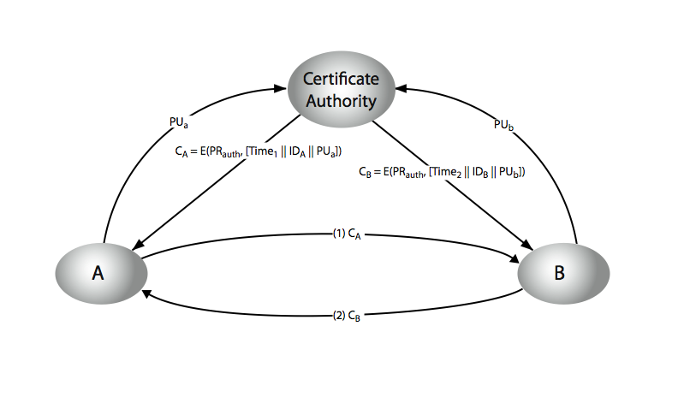
Public-Key Certificates
Notes:
Stallings Figure 10.4 “Public-Key Certificates” illustrates such a scheme. See text for details of steps in protocol.
Fig: Exchange of Public key certificatess

Slide 13
Public-Key Distribution of Secret Keys
Use previous methods to obtain public-key
Can use for secrecy or authentication
But public-key algorithms are slow
So usually want to use private-key encryption to protect message contents
Hence need a session key
Have several alternatives for negotiating a suitable session
Notes:
Once public keys have been distributed or have become accessible, secure communication that thwarts eavesdropping, tampering, or both, is possible. However, few users will wish to make exclusive use of public-key encryption for communication because of the relatively slow data rates that can be achieved. Accordingly, public-key encryption provides for the distribution of secret keys to be used for conventional encryption.

Slide 14
Simple Secret Key Distribution
Proposed by Merkle in 1979
  A generates a new temporary public key pair
  A sends B the public key and their identity
  B generates a session key K sends it to A encrypted using the supplied public key
  A decrypts the session key and both use
Problem is that an opponent can intercept and impersonate both halves of protocol
Notes:
An extremely simple scheme was put forward by Merkle [MERK79]. But it is insecure against an adversary who can intercept messages and then either relay the intercepted message or substitute another message. Such an attack is known as a man-in-the-middle attack [RIVE84].

Slide 15
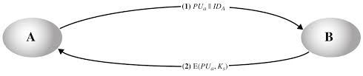
Simple Secret Key Distribution

Slide 16
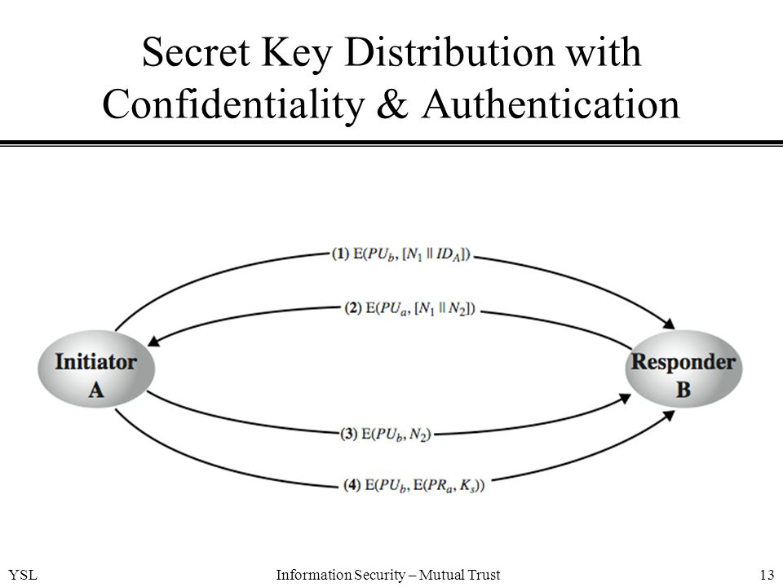
Notes:
Stallings Figure 10.6 “Public-Key Distribution of Secret Keys” illustrates such an exchange. See text for details of steps in protocol. Note that these steps correspond to final 3 of Figure 10.3, hence can get both secret key exchange and authentication in a single protocol.
if have securely exchanged public-keys:

Slide 17
Hybrid Key Distribution
Retain use of private-key KDC
Shares secret master key with each user
Distributes session key using master key
Public-key used to distribute master keys
  especially useful with widely distributed users
Rationale
  performance
  backward compatibility
Notes:
Yet another way to use public-key encryption to distribute secret keys is a hybrid approach in use on IBM mainframes [LE93]. This scheme retains the use of a key distribution center (KDC) that shares a secret master key with each user and distributes secret session keys encrypted with the master key. A public key scheme is used to distribute the master keys. The addition of a public-key layer provides a secure, efficient means of distributing master keys. This is an advantage in a configuration in which a single KDC serves a widely distributed set of users.

Slide 18
Diffie-Hellman Key Exchange
First public-key type scheme proposed
By Diffie & Hellman in 1976 along with the exposition of public key concepts
  note: now know that Williamson (UK CESG) secretly proposed the concept in 1970
Is a practical method for public exchange of a secret key
Used in a number of commercial products
Notes:
The idea of public key schemes, and the first practical scheme, which was for key distribution only, was published in 1977 by Diffie & Hellman. The concept had been previously described in a classified report in 1970 by Williamson (UK CESG) - and subsequently declassified in 1987, see [ELLI99].

Slide 19
Diffie-Hellman Key Exchange
A public-key distribution scheme
  cannot be used to exchange an arbitrary message
  rather it can establish a common key
  known only to the two participants
Value of key depends on the participants (and their private and public key information)
Based on exponentiation in a finite (Galois) field (modulo a prime or a polynomial) - easy
Security relies on the difficulty of computing discrete logarithms (similar to factoring) – hard
Notes:
The purpose of the algorithm is to enable two users to securely exchange a key that can then be used for subsequent encryption of messages. The algorithm itself is limited to the exchange of secret values, which depends on the value of the public/private keys of the participants. The Diffie-Hellman algorithm uses exponentiation in a finite (Galois) field (modulo a prime or a polynomial), and depends for its effectiveness on the difficulty of computing discrete logarithms.

Slide 20
Diffie-Hellman Setup
All users agree on global parameters:
  large prime integer or polynomial q
  a being a primitive root mod q
Each user (eg. A) generates their key
  chooses a secret key (number): x_{A} < q
  compute their public key: y_{A} = a^{xA} mod q
Each user makes public that key y_{A}
Notes:
In the Diffie-Hellman key exchange algorithm, there are two publicly known numbers: a prime number q and an integer a that is a primitive root of q. The prime q and primitive root a can be common to all using some instance of the D-H scheme. Note that the primitive root a is a number whose powers successively generate all the elements mod q. Users Alice and Bob choose random secrets x's, and then "protect" them using exponentiation to create their public y's. For an attacker monitoring the exchange of the y's to recover either of the x's, they'd need to solve the discrete logarithm problem, which is hard.

Slide 21
Diffie-Hellman Key Exchange
Shared session key for users A & B is K_{AB}:
  K_{AB} = a^{xA.xB} mod q
  = y_{A}^{xB} mod q (which B can compute)
  = y_{B}^{xA} mod q (which A can compute)
K_{AB} is used as session key in private-key encryption scheme between Alice and Bob
If Alice and Bob subsequently communicate, they will have the same key as before, unless they choose new public-keys
Attacker needs an x, must solve discrete log
Notes:
The actual key exchange for either party consists of raising the others "public key' to power of their private key. The resulting number (or as much of as is necessary) is used as the key for a block cipher or other private key scheme. For an attacker to obtain the same value they need at least one of the secret numbers, which means solving a discrete log, which is computationally infeasible given large enough numbers. Note that if Alice and Bob subsequently communicate, they will have the same key as before, unless they choose new public-keys.

Slide 22
Diffie-Hellman Example
Users Alice & Bob who wish to swap keys:
Agree on prime q=353 and a=3
Select random secret keys:
  A chooses x_{A}=97, B chooses x_{B}=233
Compute respective public keys:
  y_{A}=3⁹⁷ mod 353 = 40 (Alice)
  y_{B}=3²³³ mod 353 = 248 (Bob)
Compute shared session key as:
  K_{AB}= y_{B}^{xA} mod 353 = 248⁹⁷ = 160 (Alice)
  K_{AB}= y_{A}^{xB} mod 353 = 40²³³ = 160 (Bob)
Notes:
Here is an example of Diffie-Hellman from the text.

Slide 23
Key Exchange Protocols
Users could create random private/public D-H keys each time they communicate
Users could create a known private/public D-H key and publish in a directory, then consulted and used to securely communicate with them
Both of these are vulnerable to a meet-in-the-Middle Attack
Authentication of the keys is needed
Notes:
Detail a couple of possible Key Exchange Protocols based on Diffie-Hellman. Note that these are vulnerable to a meet-in-the-Middle Attack, and that authentication of the keys is needed.

